Slide 1
6. Playing with Multimedia
서보경

Slide 2
목차
Working with Audio
Transforming Images
Playing with Video

Slide 3


1. Working with Audio - Playing Music
play
Ogg123 (Ogg Vorbis)
mpg321 (mp3)

Slide 4
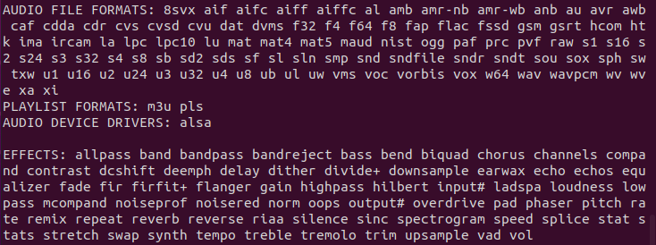
1. Working with Audio - Playing Music
‘sox’ package
$sox –h
$play sample3.wav

Slide 5
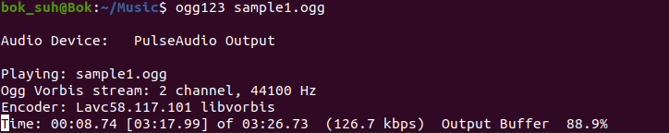
1. Working with Audio - Playing Music
‘vorbis-tools’ package
$ogg123 sample1.ogg
‘Ctrl+c’ (다음 곡으로 스킵)
‘Ctrl+c‘ 두 번 (종료)

Slide 6
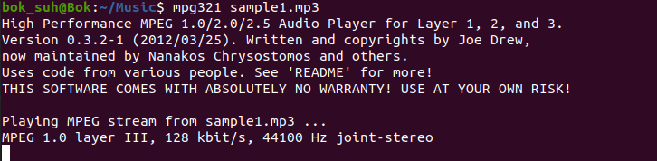
1. Working with Audio - Playing Music
‘mpg321’ package
$mpg321 sample1.mp3
$mpg321 –z *.mp3 (pseudo-random order)
$mpg321 –Z *.mp3 (-z와 같으나 무한 반복)

Slide 7
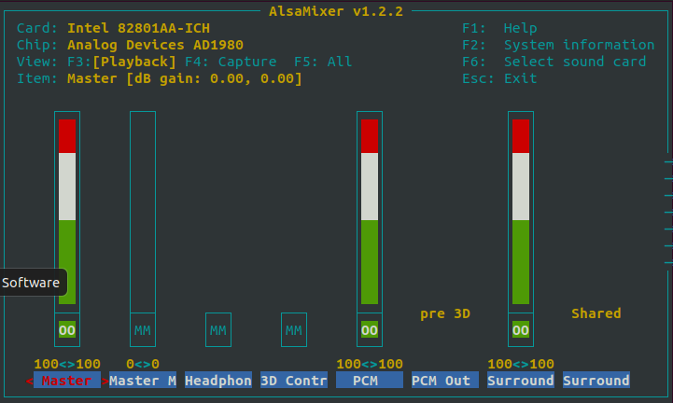
1. Working with Audio - Adjusting Audio Levels
ALSA (Advanced Linux Sound Architecture)
OSS (OpenSourceSoundSystem) : 구식
$alsamixer

Slide 8
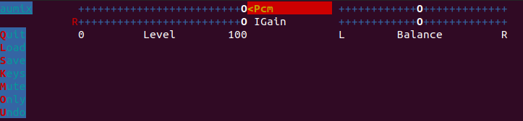

1. Working with Audio - Adjusting Audio Levels
‘aumix’ package
$aumix
$aumix -q

Slide 9
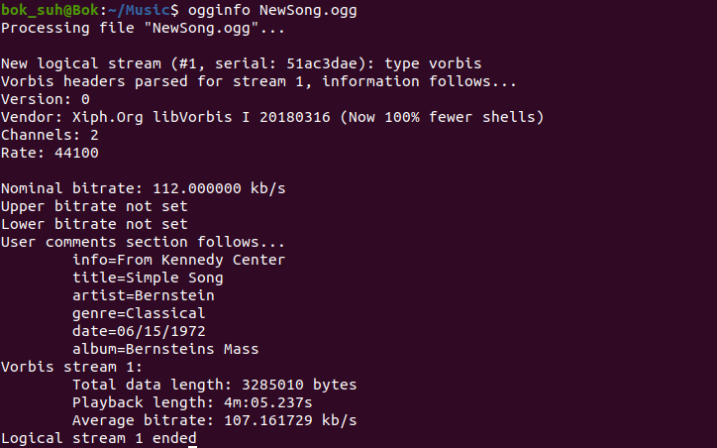
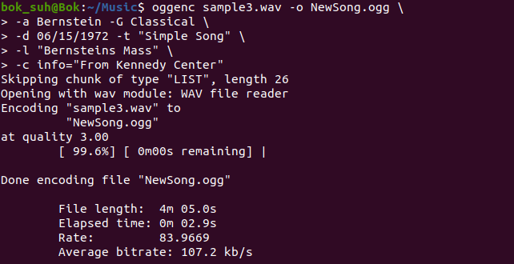
1. Working with Audio - Encoding Music
oggenc

Slide 10
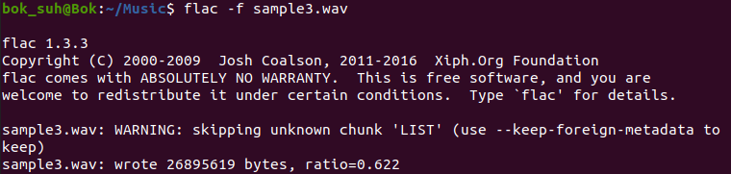
1. Working with Audio - Encoding Music
‘flac’ package
$flac sample3.wav

Slide 11
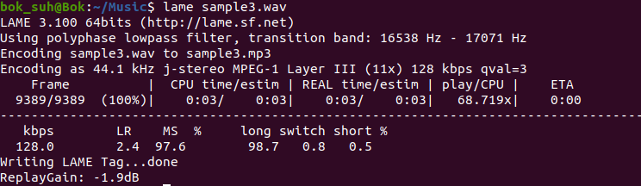
1. Working with Audio - Encoding Music
‘lame’ package
$lame sample3.wav

Slide 12
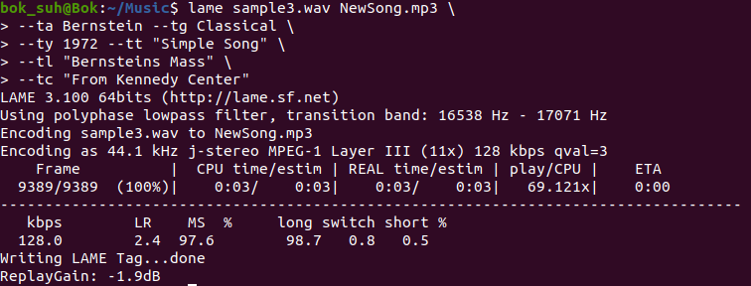
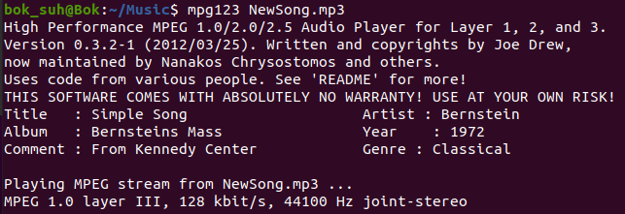
1. Working with Audio - Encoding Music

Slide 13
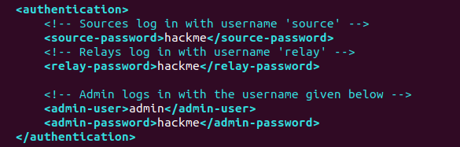
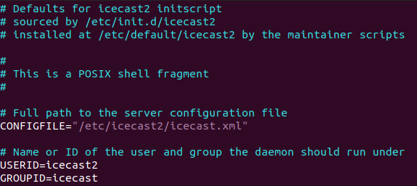
1. Working with Audio - Streaming Music
‘icecast2’, ‘ices2’ packages
비밀번호 수정하기
ENABLE = true

Slide 14

1. Working with Audio - Streaming Music
3. 서버 시작하기
4. 디렉토리 만들기
5. 플레이리스트 만들기
6. 복사 후 저장하기

Slide 15
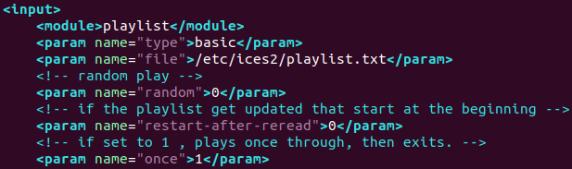
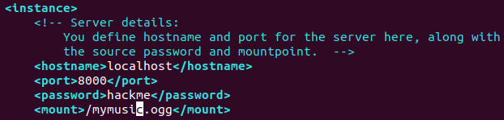
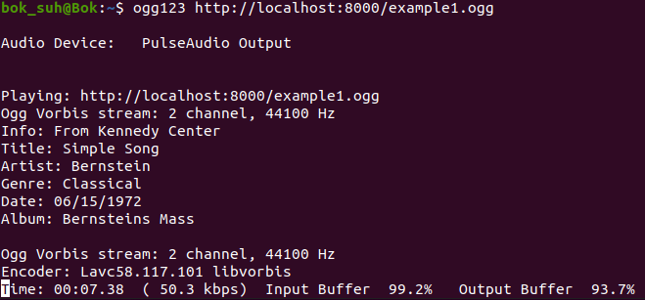
1. Working with Audio - Streaming Music
7. ices-playlist.xml 수정하기
8. 실행하기

Slide 16
1. Working with Audio - Streaming Music
9. 종료하기

Slide 17
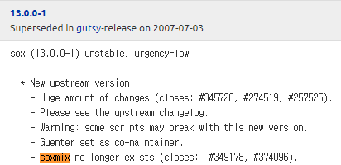
1. Working with Audio - Converting Audio Files
$sox head.wav tail.wav output.wav (합치기)
$soxmix sound1.wav sound2.wav ouput.wav (믹스)
$sox sound1.wav ouput.wav trim 4 (지우기)

Slide 18
2. Transforming Images - Getting Information about Images
사진 파일 정보 보기

Slide 19
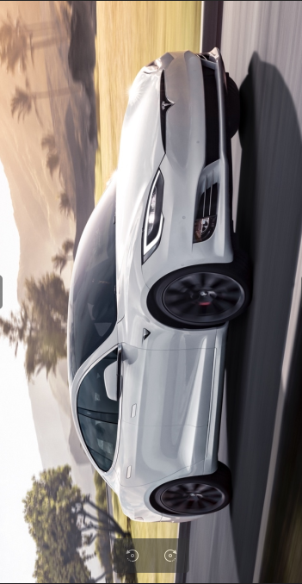


2. Transforming Images - Converting Images
포멧 바꾸기
사이즈 바꾸기
회전하기
텍스트 넣기

Slide 20



2. Transforming Images - Converting Images
썸네일 만들기

Slide 21
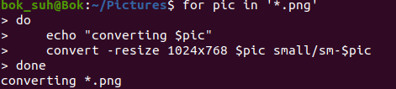
2. Transforming Images - Converting Images in Batches
디렉토리 안의 이미지 전체 수정

Slide 22
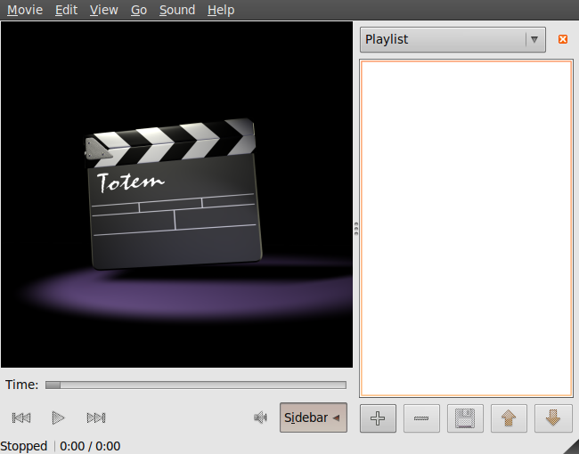

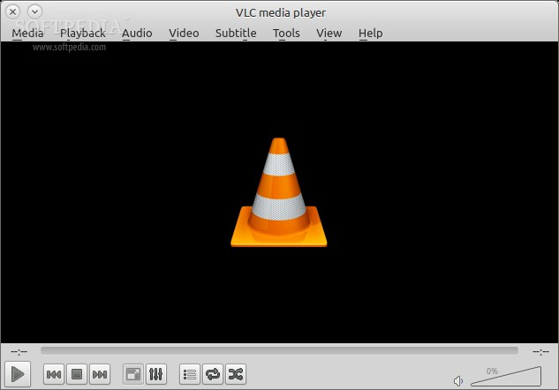

3. Playing with Video - Playing Video Files
Totem
Mplayer
Xine
VLC

Slide 23
3. Playing with Video - Installing Video Software - Starting the DVD player
gstreamer1.0-plugins-good
libdvdcss
$sudo apt-get install libdvd-pkg
$sudo dpkg-reconfigure libdvd-pkg
실행하기
$mplayer dvd://

Slide 24
감사합니다.

